Slide 1


Gridlock Buster
Team 5: Interns in Training
___________________________________
Sherla, Anna, Brian, Omar, Nora, Greg, Karson, Alvin
Notes:
Greg
Presenter: Anna

Slide 2
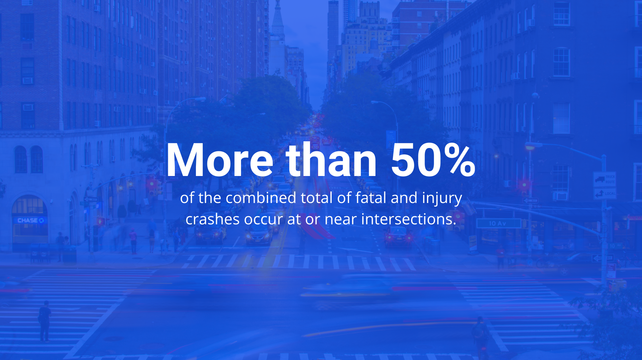
Notes:
Anna
Presenter: Anna

Slide 3
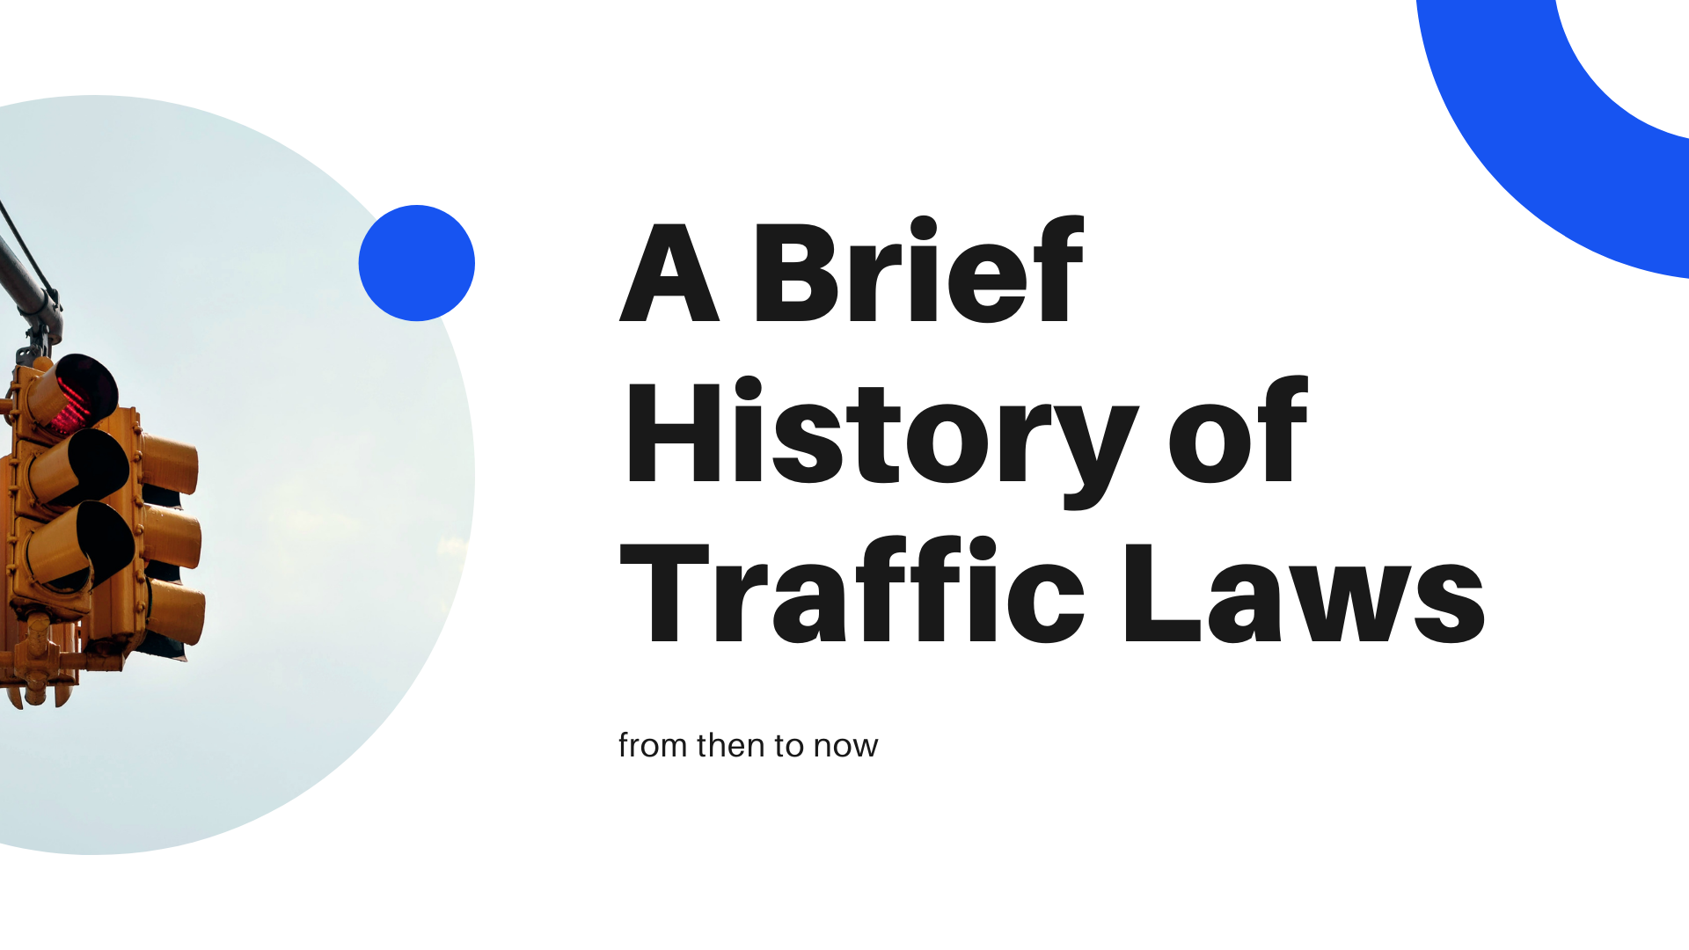

Slide 4
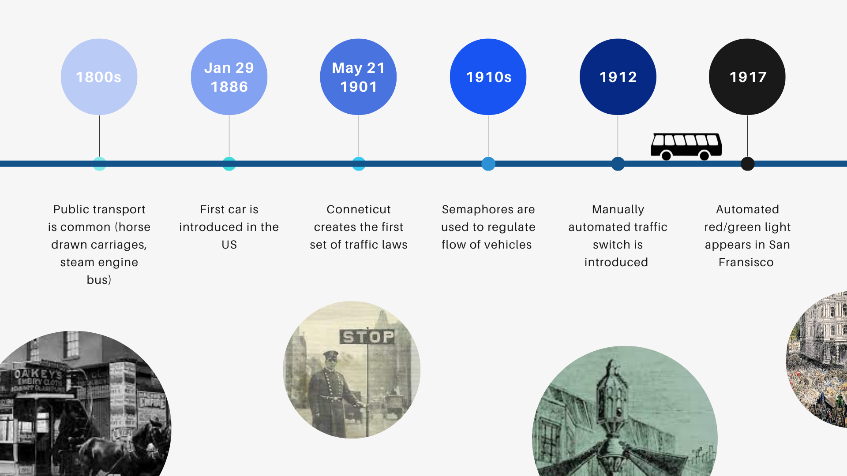
Notes:
May 21st, 1901 - Connecticut creates the first set of traffic laws, regulating speeds to 12mph and 15mph on country roads
1860s - first traffic light is created, poor quality (red gas lights stop at night and green gas lights go during the day), only caution and stop
Circa 1880s-90s - slowing down to wait for other wagons and carriages was expected once reaching an intersection (actually created in order to prevent other wagons from scaring the horses/other animals)
1910s - semaphores begin to take shape, manual or automatic
1912 - manually switched traffic light is created

Slide 5
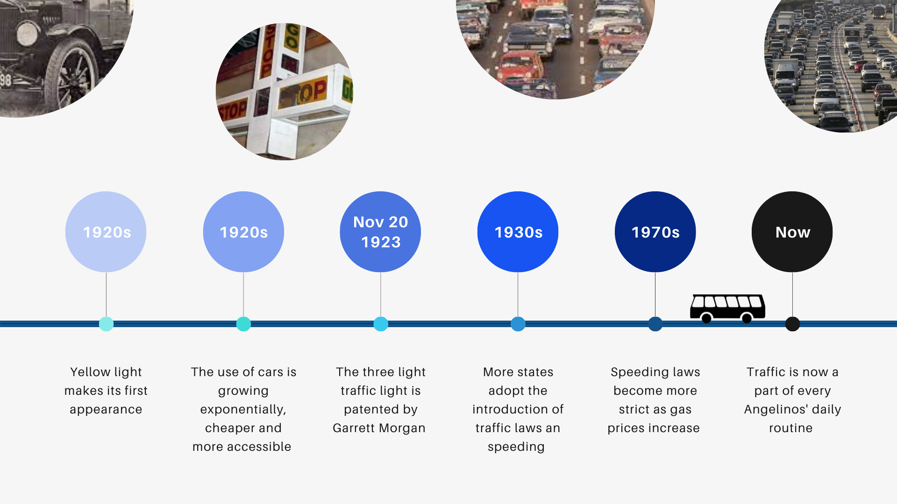
Notes:
What we learned?
-a flow of traffic and automobile transport is best with coordinated movement signals and with compliance to a uniform set of expectations for each driver
-as industrial expansion increases and there is a larger population, congestion will continue to be a conflict
-quicker and smoother flow from point a to point b is a universal goal

Slide 6
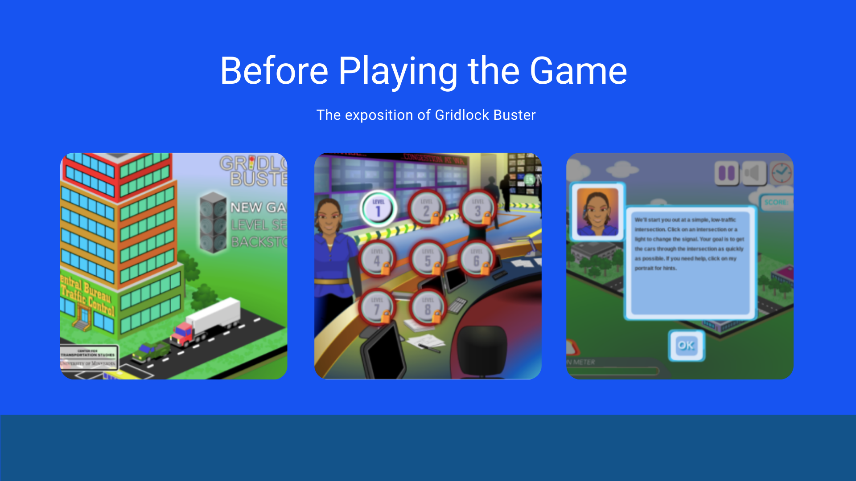
Notes:
Quick intro to the game! Gridlock Buster is a online web browser game created by the university of minnesota that challenges players to manage traffic flow by controlling the traffic lights at the intersections. On the left we have the load up page of the game. Gridlock buster can be accessed from any web browser. You'll be prompted to start a new game upon load up and from the middle photo you can see that there are currently 8 levels to the game. Once you start a level, you will be greeted by an assistant named vivian who is there to guide you throughout you gameplay

Slide 7
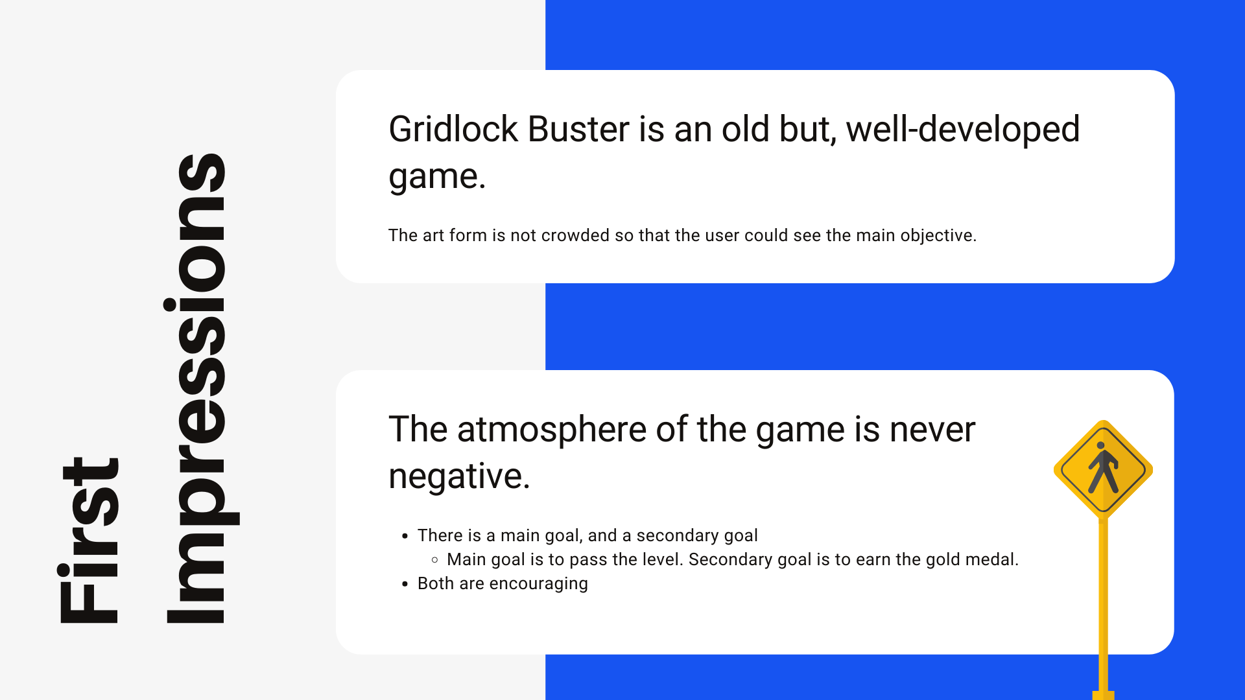
Notes:
Presenter: Sherla
At first glance, we noticed that the game seems a bit old with its style but still very well developed. There are 2 main objectives to the game, the first being to clear the level without being stopped by the frustration meter that keeps track of the car build up. The second goal is to beat the level with a high enough score to get a gold medal, with each level having a different source requirement. We also realized that the game has a very positive atmosphere and is always encouraging even after failed attempts

Slide 8
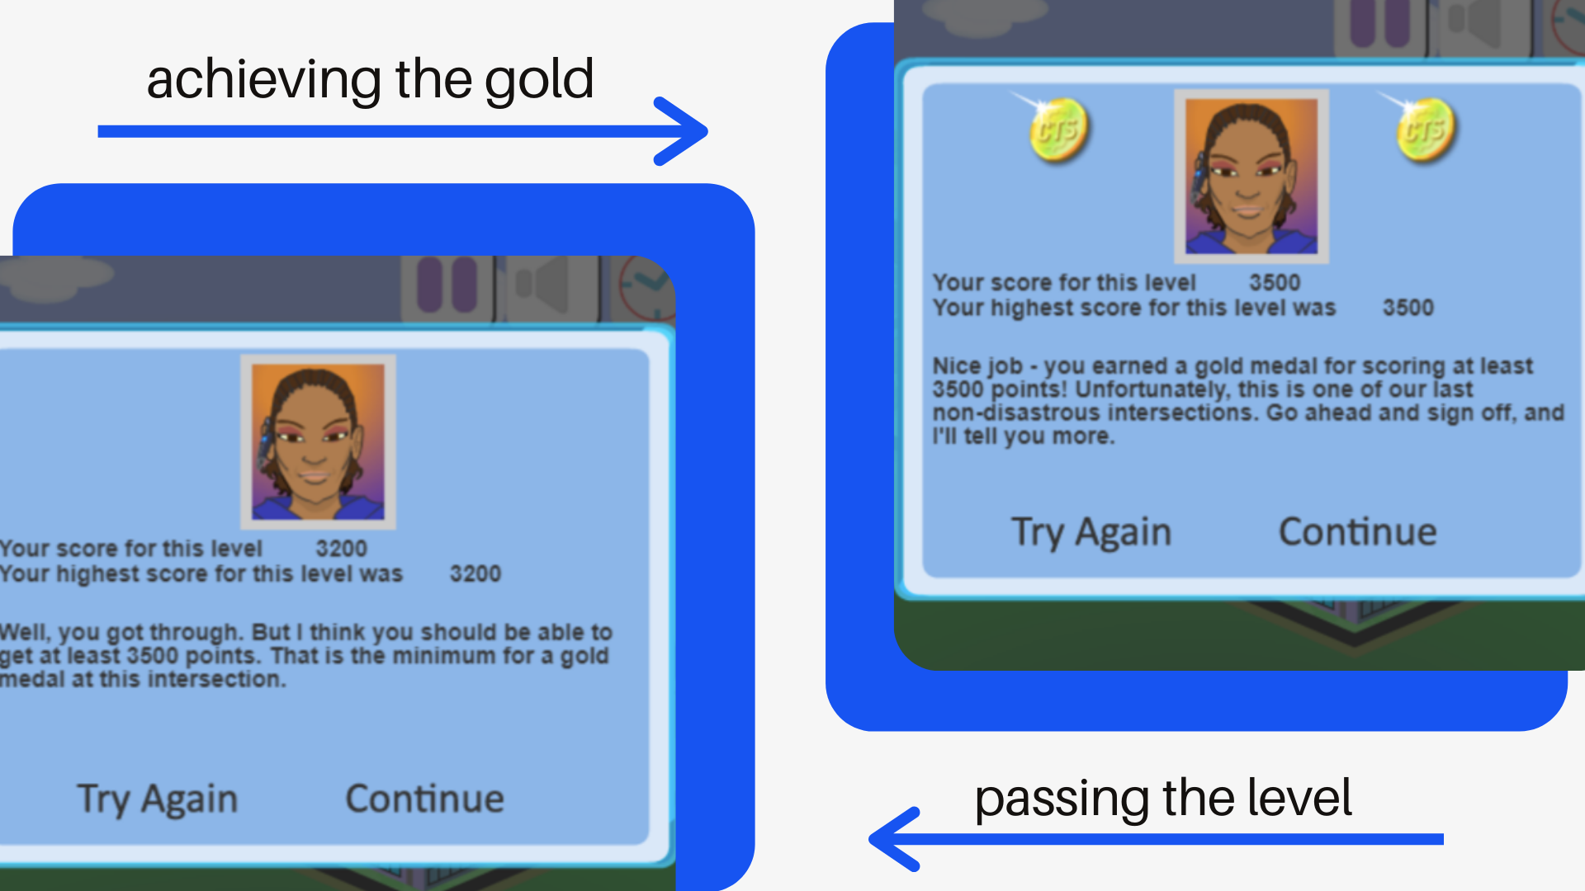

Slide 9

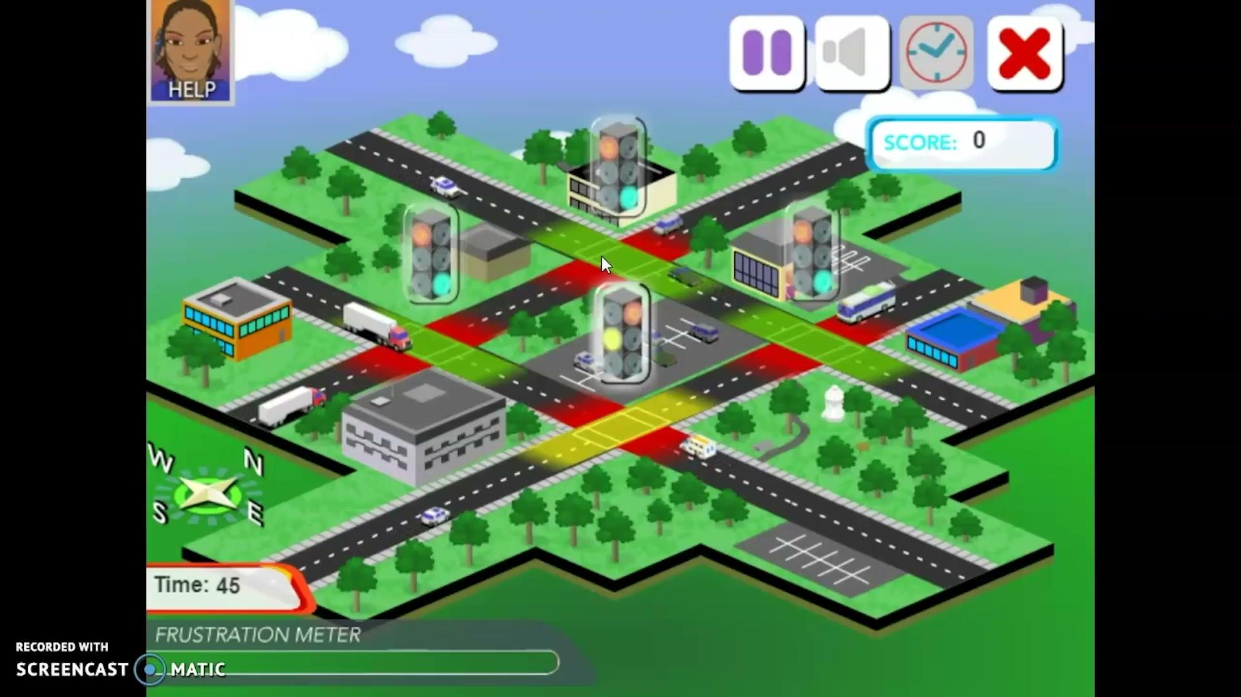
Notes:
Presenter: Sherla
So now we’d like to share with you a short game review our team have created!

Slide 10
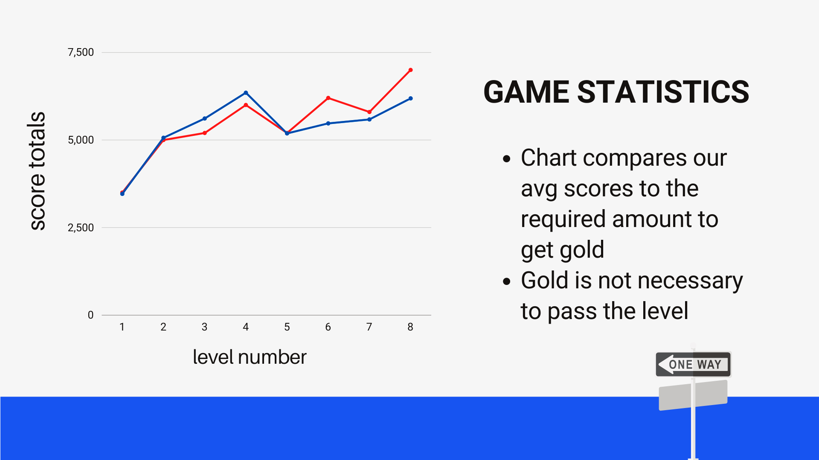
Notes:
The gridlock buster game includes 8 levels. When playing the game there is a minimum score required to receive gold on a level. All members of our group played the game and we averaged our scores for each level and compared them to the minimum requirement to get gold. When looking at the graph you can see that on average we did better than the minimum up until level 5. This is because the remote control was introduced into the game adding to the difficulty and complexity of the game. Which is reflected in our scores after level 5 where we fall below the minimum. As an added note the game did provide an actual number to denote the minimum to pass the actual level.
Presenter: Anna

Slide 11
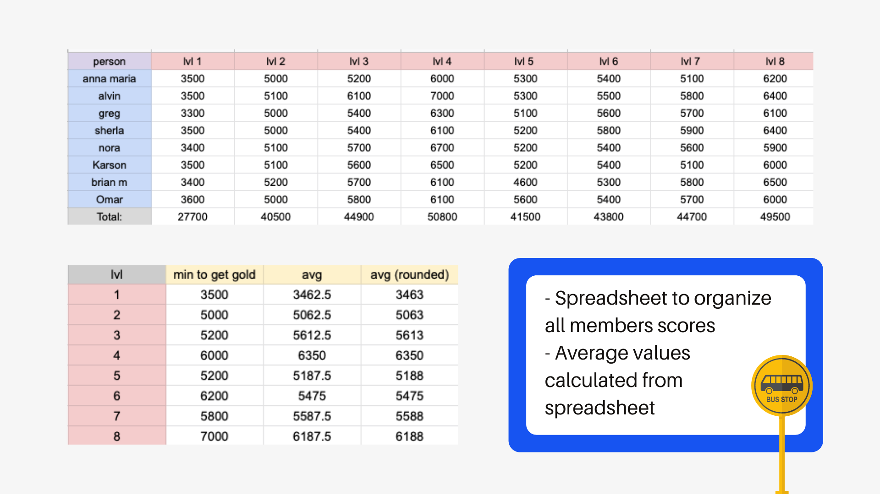
Notes:
Here is the the spreadsheet we used to organize all members scores and calculate the average for the graph in the previous slide. There are also screenshots our group members took as evidence of playing the game
Presenter: Anna

Slide 12
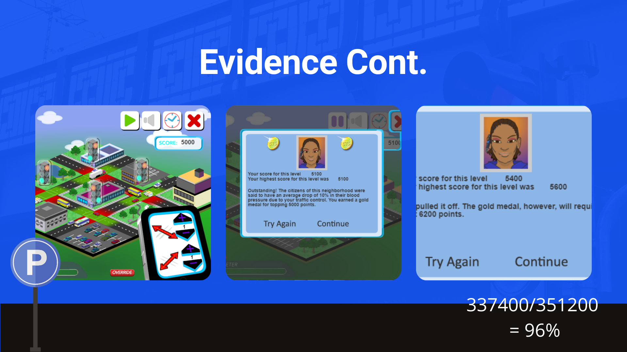
Notes:
Plxz if this doenst tell u i hat being alive idk what to say
Our total score combined was 337400 out of 351200, which is the minimum to get gold multiplied by 8 to account for all 8 members. Percentage wise that rounds out to 96 percent.
Presenter: Anna

Slide 13
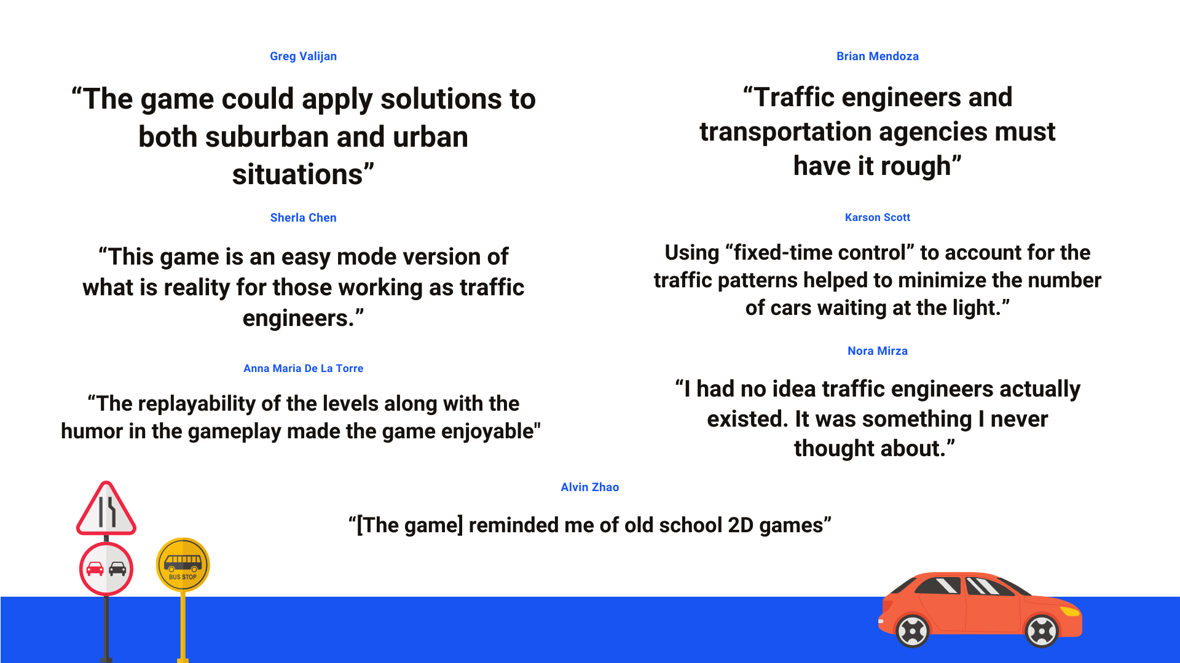
Notes:
Presenter: Sherla
So another element to our project included individual essay reflections. Here we have a few quotes from some of our essays. Since this slide is a bit wordy, I’ll highlight a few! In his essay, Greg said ____. He referenced some of the possible ways for gridlock to improve their game. In both Brian and my essay, we both reflected on our thoughts about traffic engineers after getting a small taste of their workload. This brings me to Nora’s comment about having no idea traffic engineers existed! (Elaborate)

Slide 14
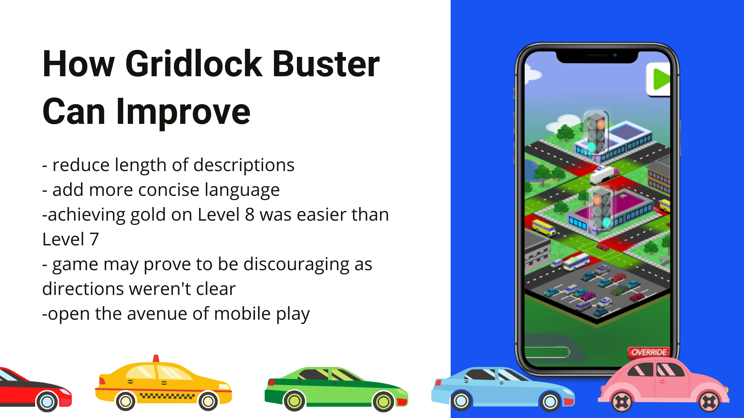
Notes:
Presenter: Sherla
So here we have a few suggestions for improving the game Gridlock Buster itself through
First, we noticed that the instructions were pretty lengthy in some sections of game. This made the rather simple directions to be more complex than they needed to be.
Apart from the previous mentioned suggestions, we also advise for the game levels to gradually increase in difficulty in sequential order. We realized that some of the latter levels were actually harder than future levels which was a bit odd.
The ambiguity of the instructions could also discourage many players from trying again, since the basics of the game were not explained fully
Apart from the previous mentioned suggestions, we also advise for the game levels to gradually increase in difficulty in sequential order. We realized that some of the latter levels were actually harder than future levels which was a bit odd.
In the end, we appreciated the game and we could see this opening up the future of mobile device play to reach a wider audience.

Slide 15
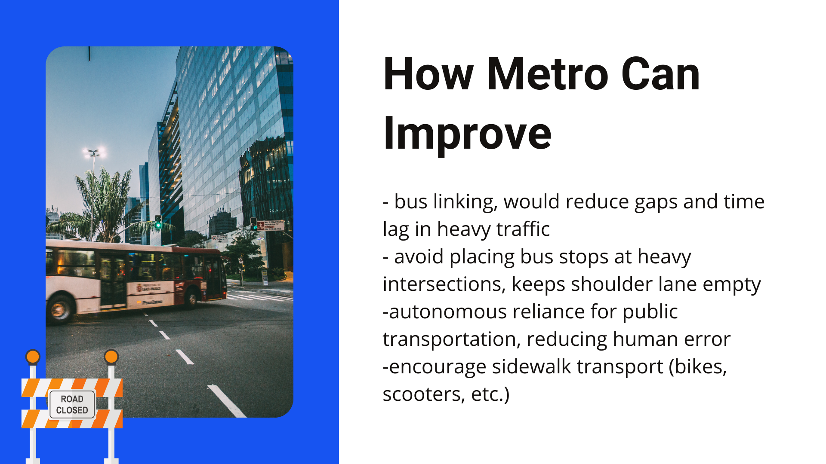
Notes:
Presenter: Sherla
So here we have a few suggestions for improving traffic through metro
For metro we suggest introducing the method of bus linking where buses would trail each other, therefore reducing the gap. This would also be more effective for bus riders.
Another suggestion would be to avoid placing bus stops near corners of busy intersections. Doing so would free the congestion that would otherwise be building up behind a boarding bus.
Autonomous reliance for vehicles is also a suggestion as this would reduce human error on intersections
And as always, less cars are better than more cars on an intersection, so alternatives such as a scooter and bicycle that are already in circulation prove to be beneficial

Slide 16
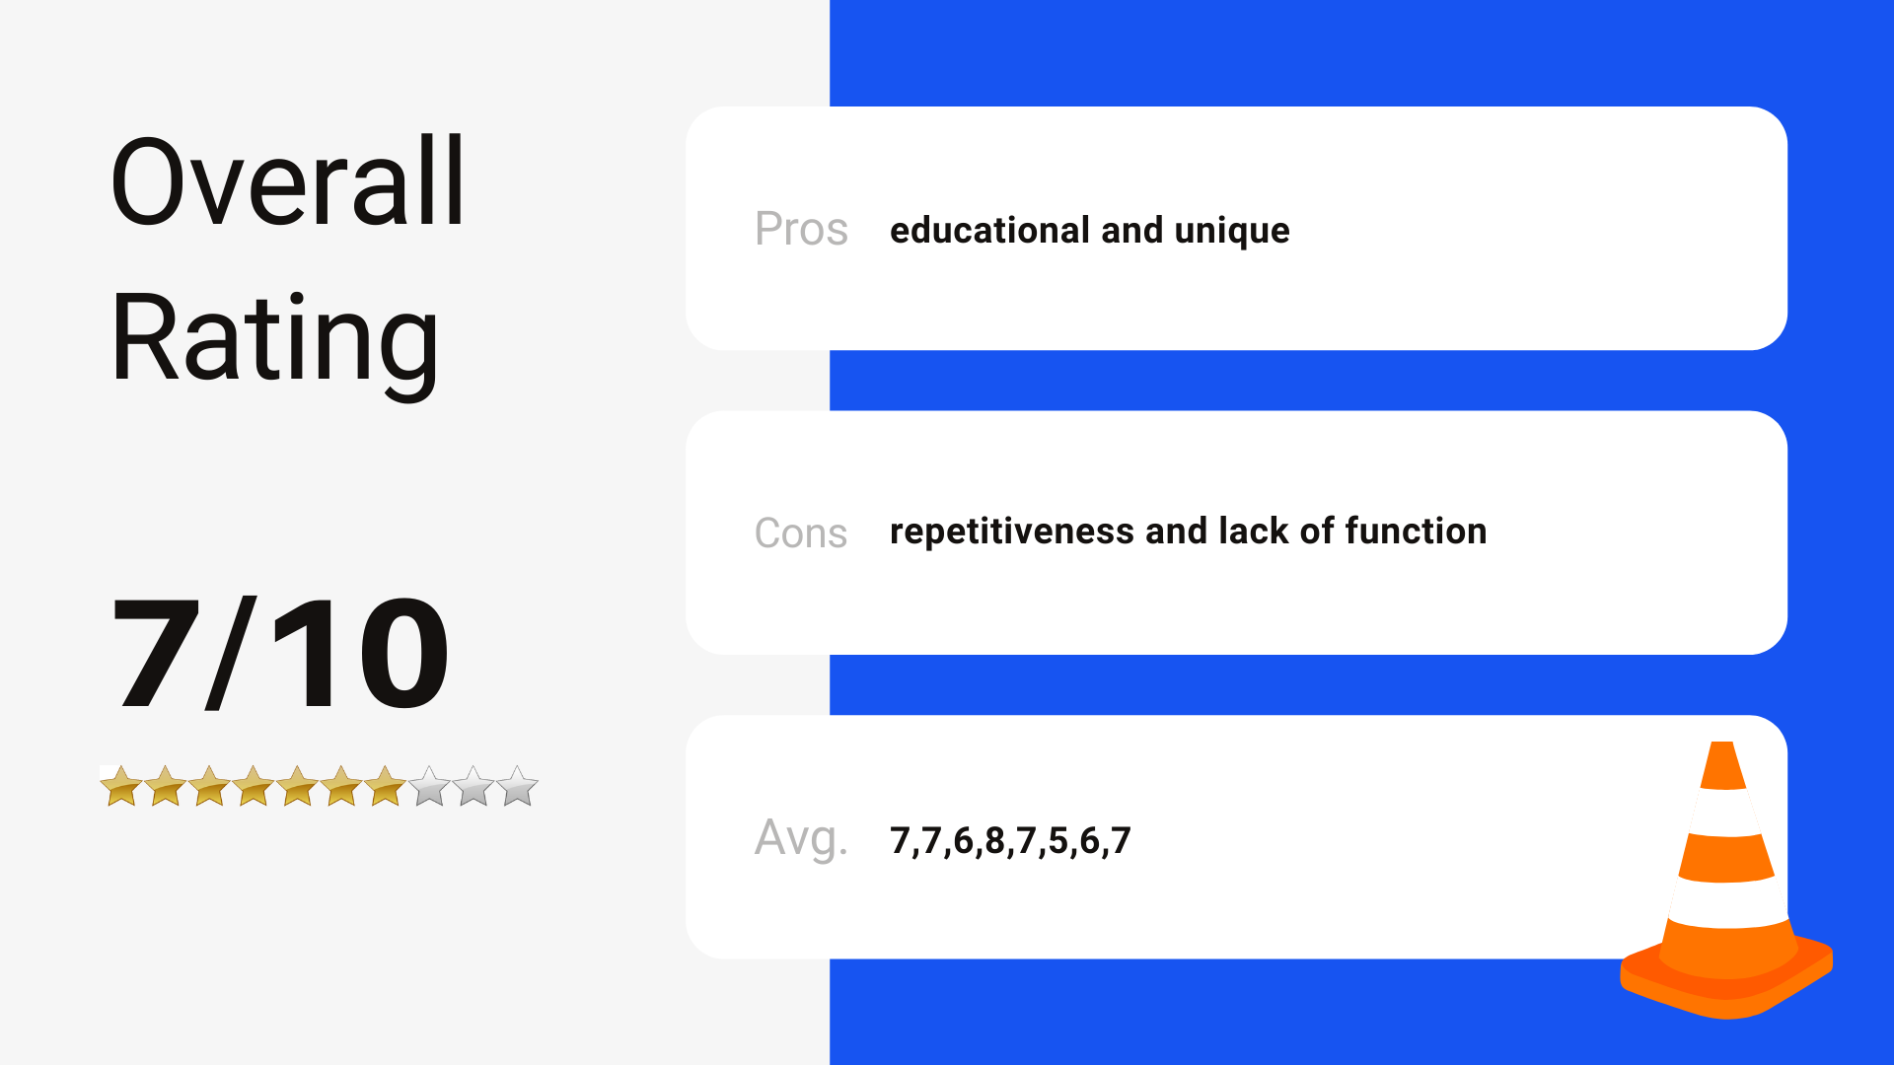
Notes:
Other things said about the game are:
“And as for how the game functions, you would always want to play for the gold medal, but some levels such as the first level, makes it very discouraging to continue as getting that golden medal was merely impossible.”
“The game gives a good understanding about how the flow of cars can affect traffic”
“The game provided a good understanding of traffic and it’s problems, but is not great for understanding exactly how to solve traffic issues or finding the best solutions in general”
Presenter: Sherla
So after playing the game and analyzing it, our team has decided to rate the game a 7/10. The game itself is fun and offers a great understanding of the flow of cars during traffic but it is lacking a bit of function and kind of gets repetitive with similar levels. Although it offers a great challenge with aiming for gold medals, the difficulty of obtaining the medal in the beginning of the game can also be very frustrating and discouraging.

Slide 17
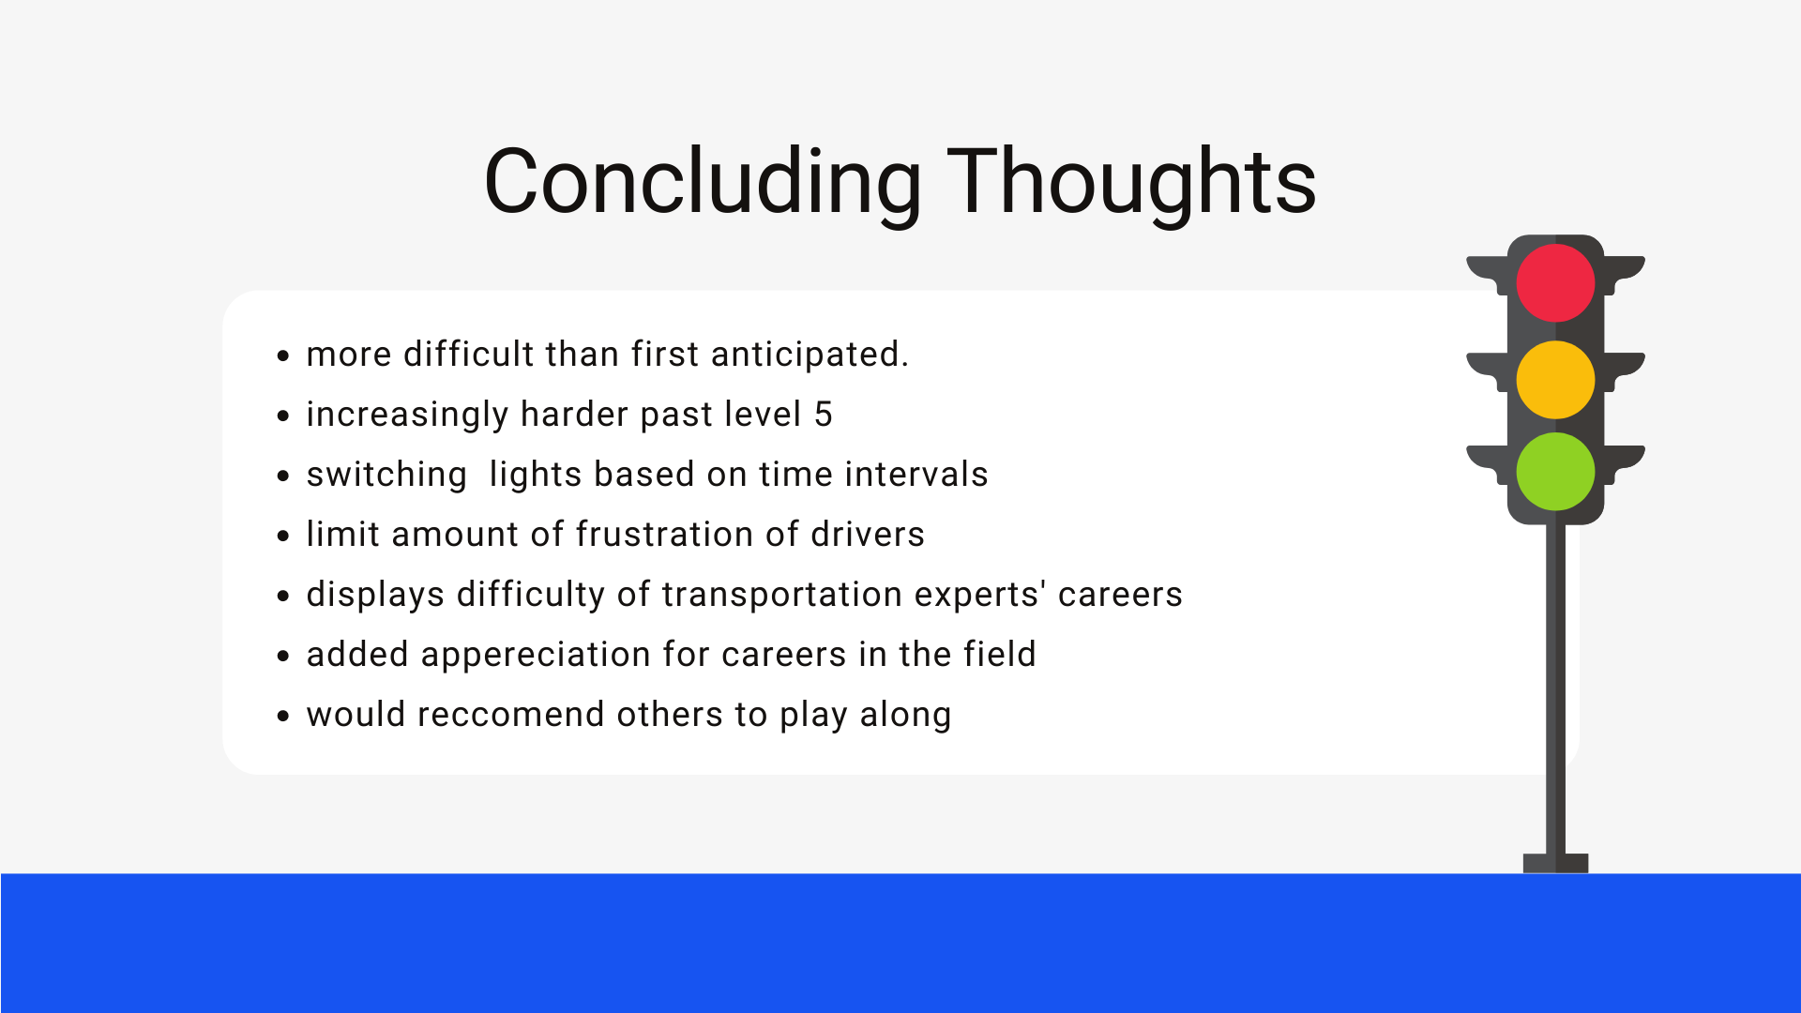
Notes:
Omar
Presenter: Anna

Slide 18


